Slide 1
WELCOME
TO OUR WEBSITE
CODEBUG

Slide 2

LOGIN PAGE

Slide 3
Here is our login page, we can login in this website with the help of your name and password . You should remember your password so that in future you can securely enter in our website.
After enter your name and password click on login button to login our website . In the login page we use HTML and CSS languages .After logging in the login page we enter in the document page.

Slide 4
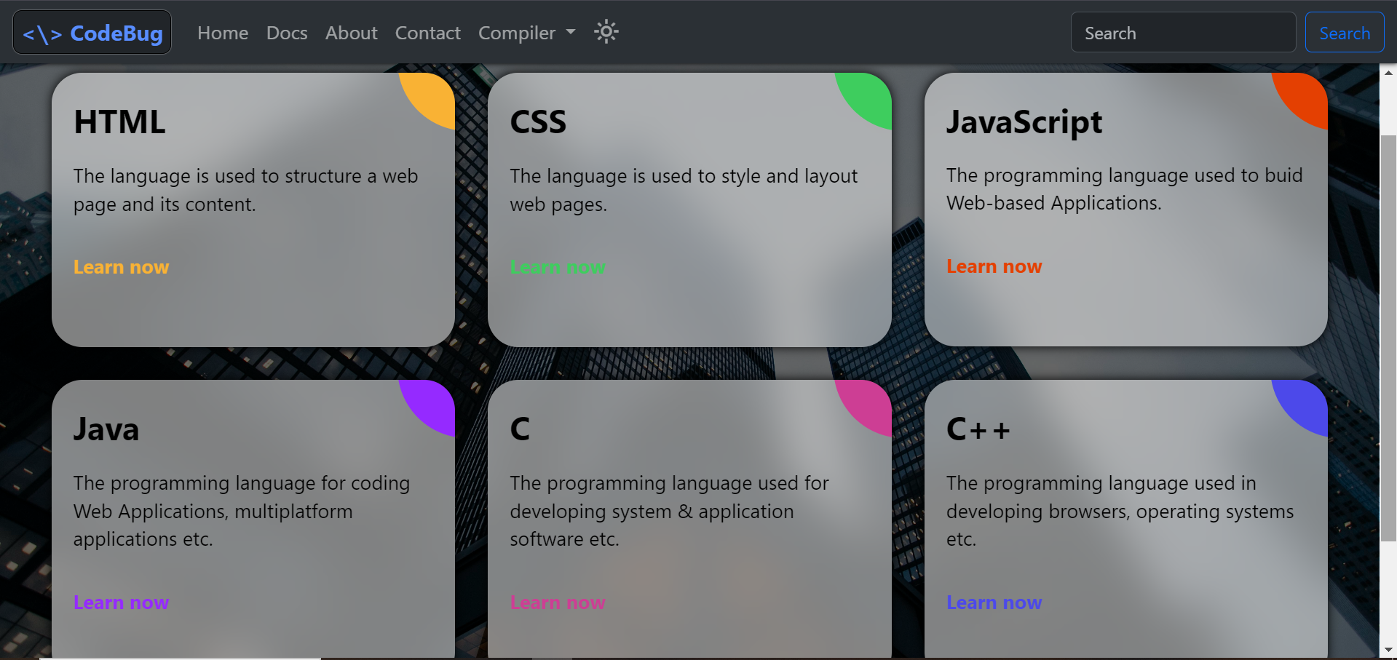
DOCUMENT PAGE

Slide 6
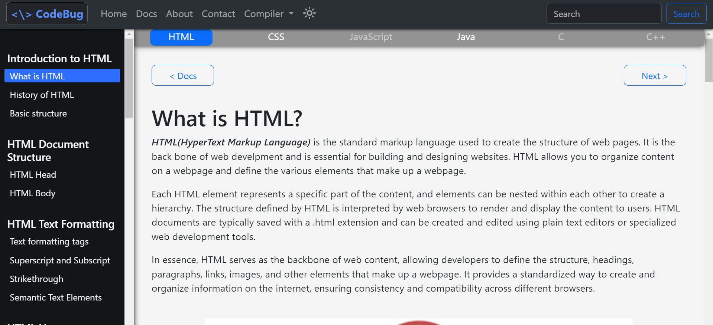
HTML PAGE

Slide 7
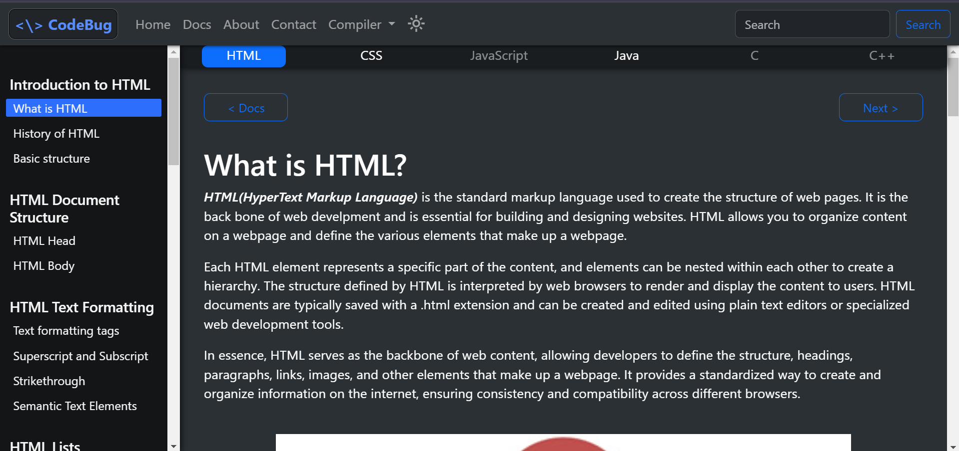
HTML IN DARKMODE

Slide 8
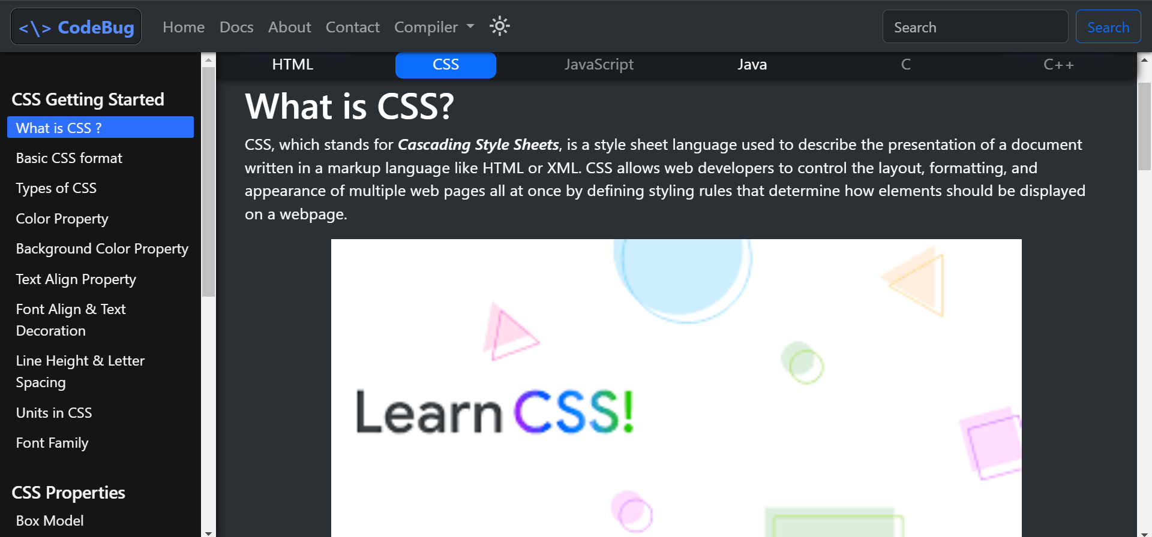
CSS PAGE

Slide 9
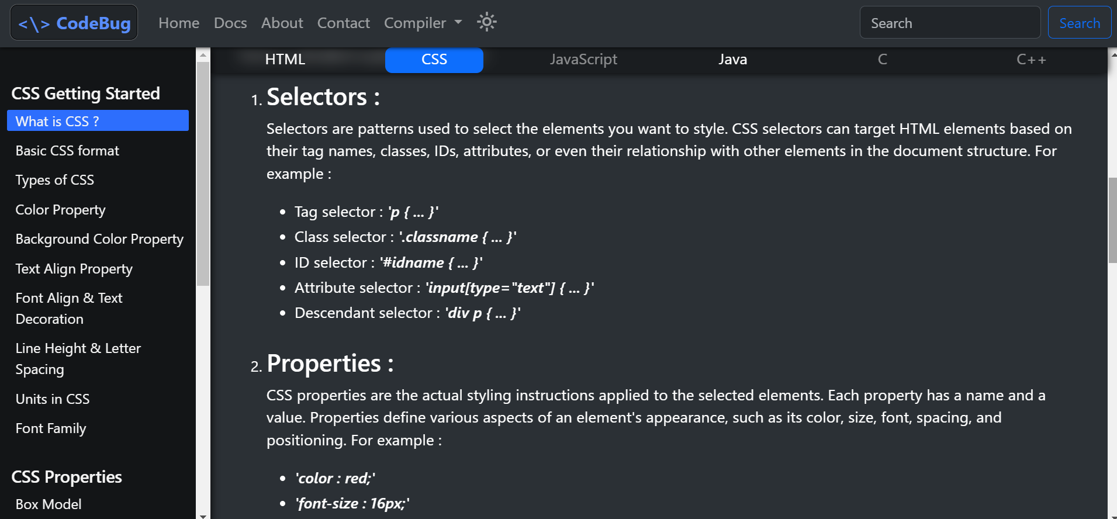

Slide 10
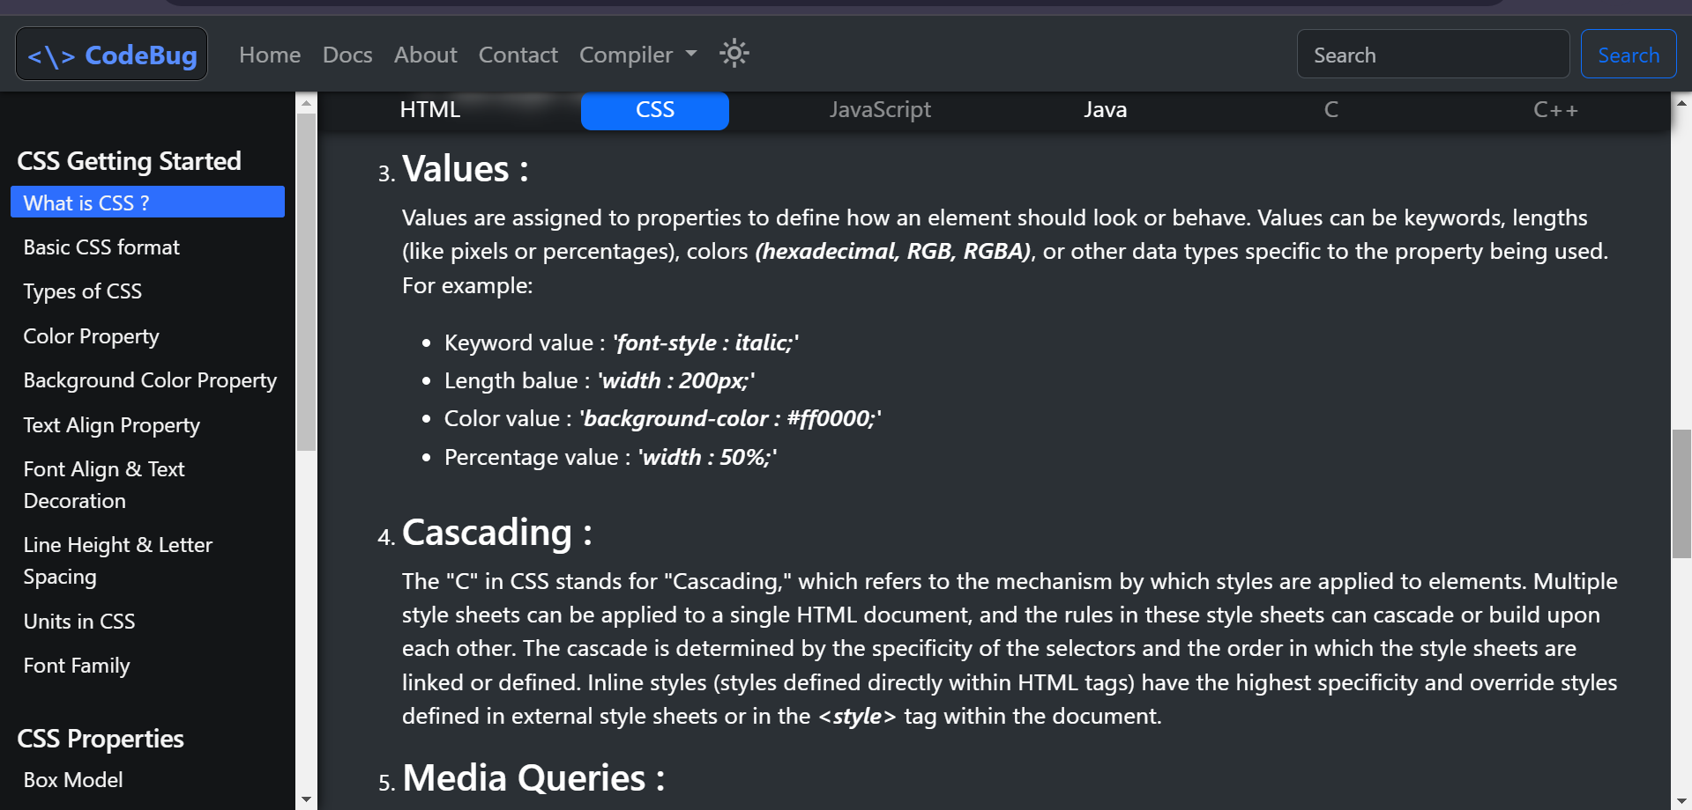

Slide 11
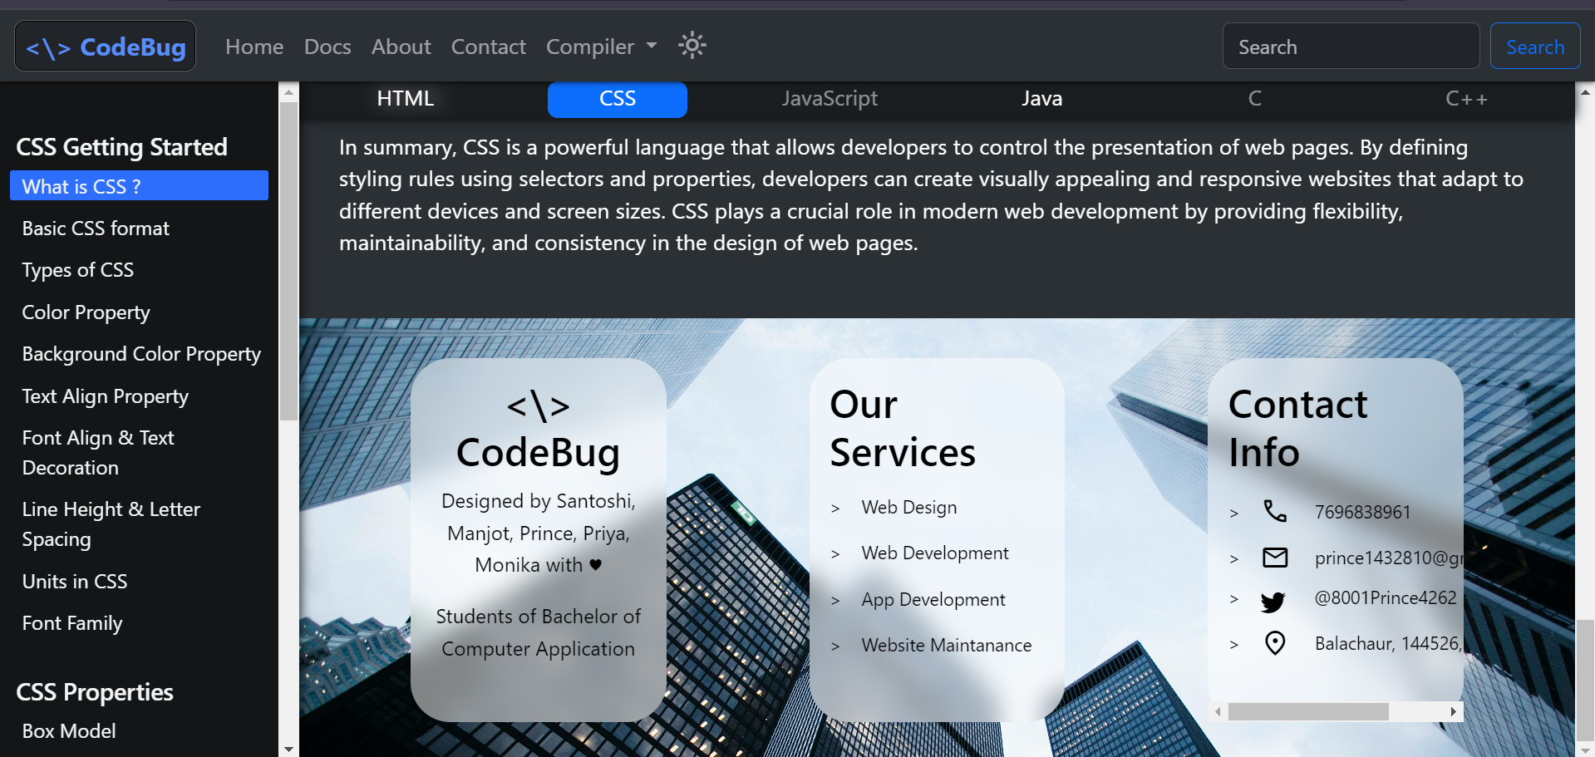

Slide 12
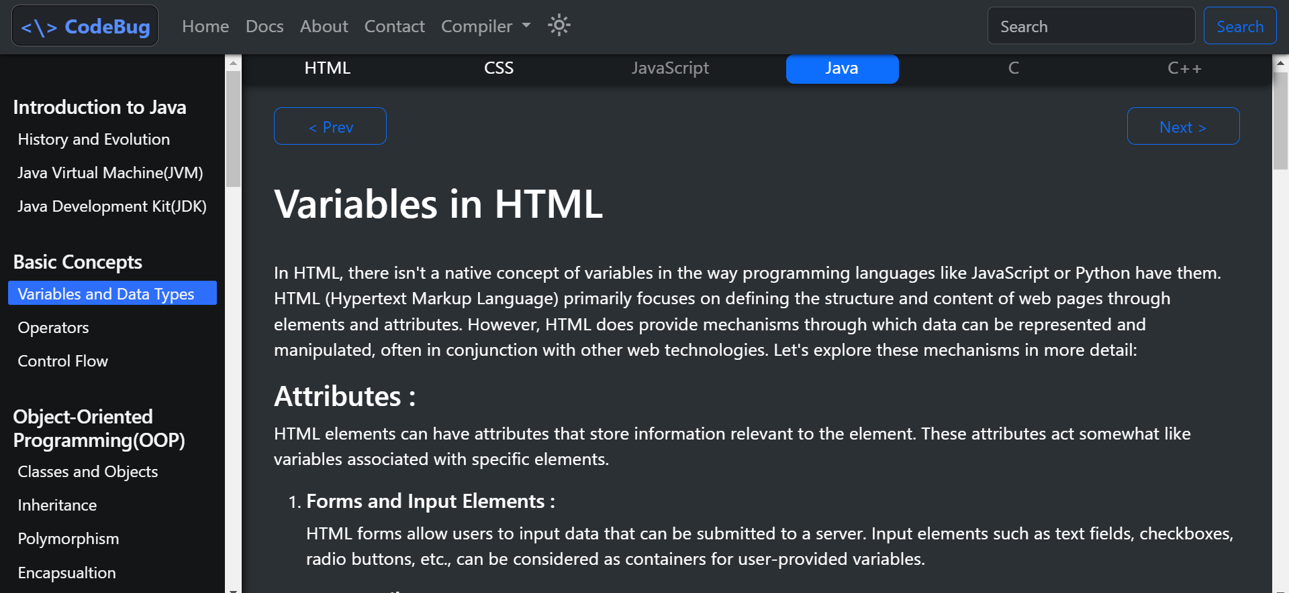
JAVA PAGE

Slide 13
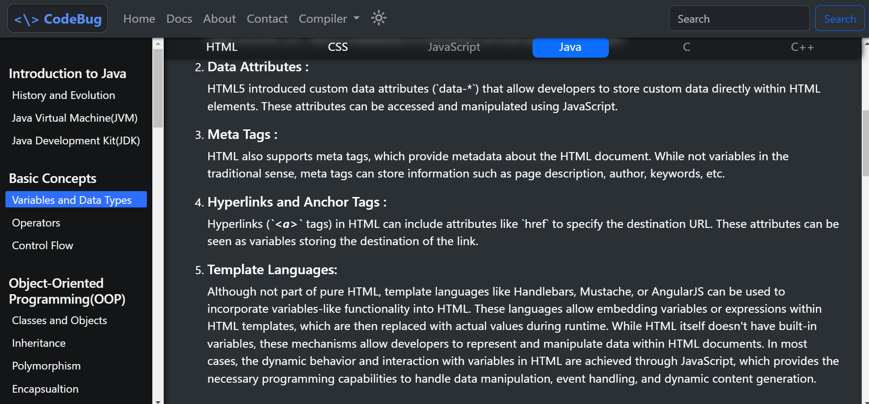

Slide 14
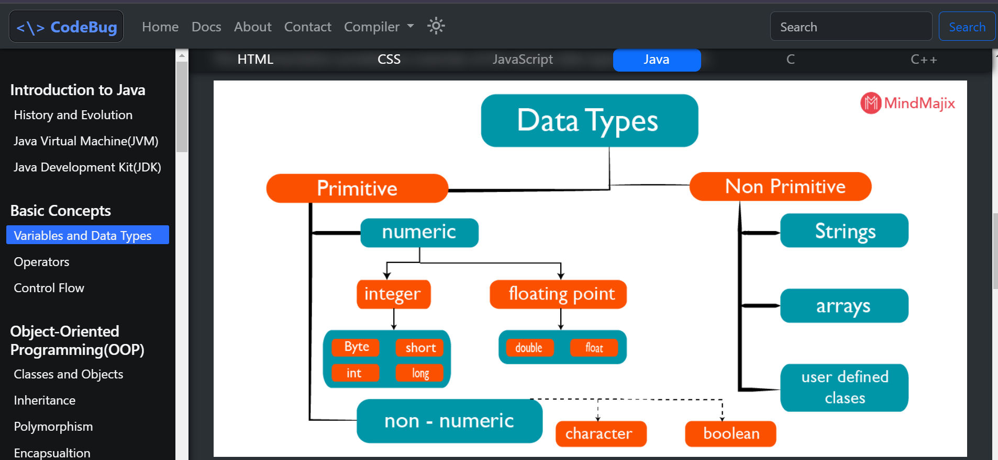

Slide 15
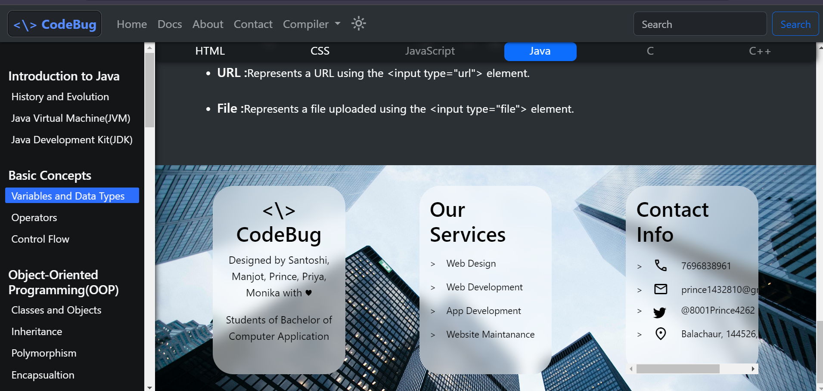

Slide 16
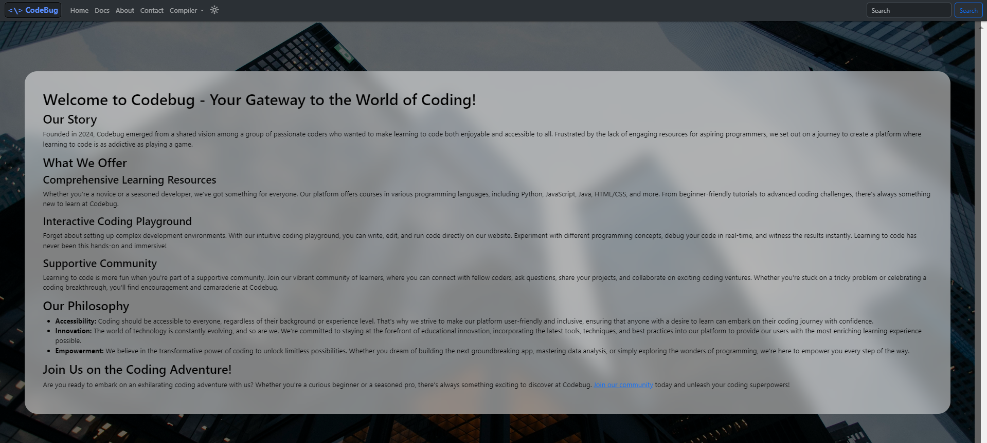
ABOUT US PAGE

Slide 18
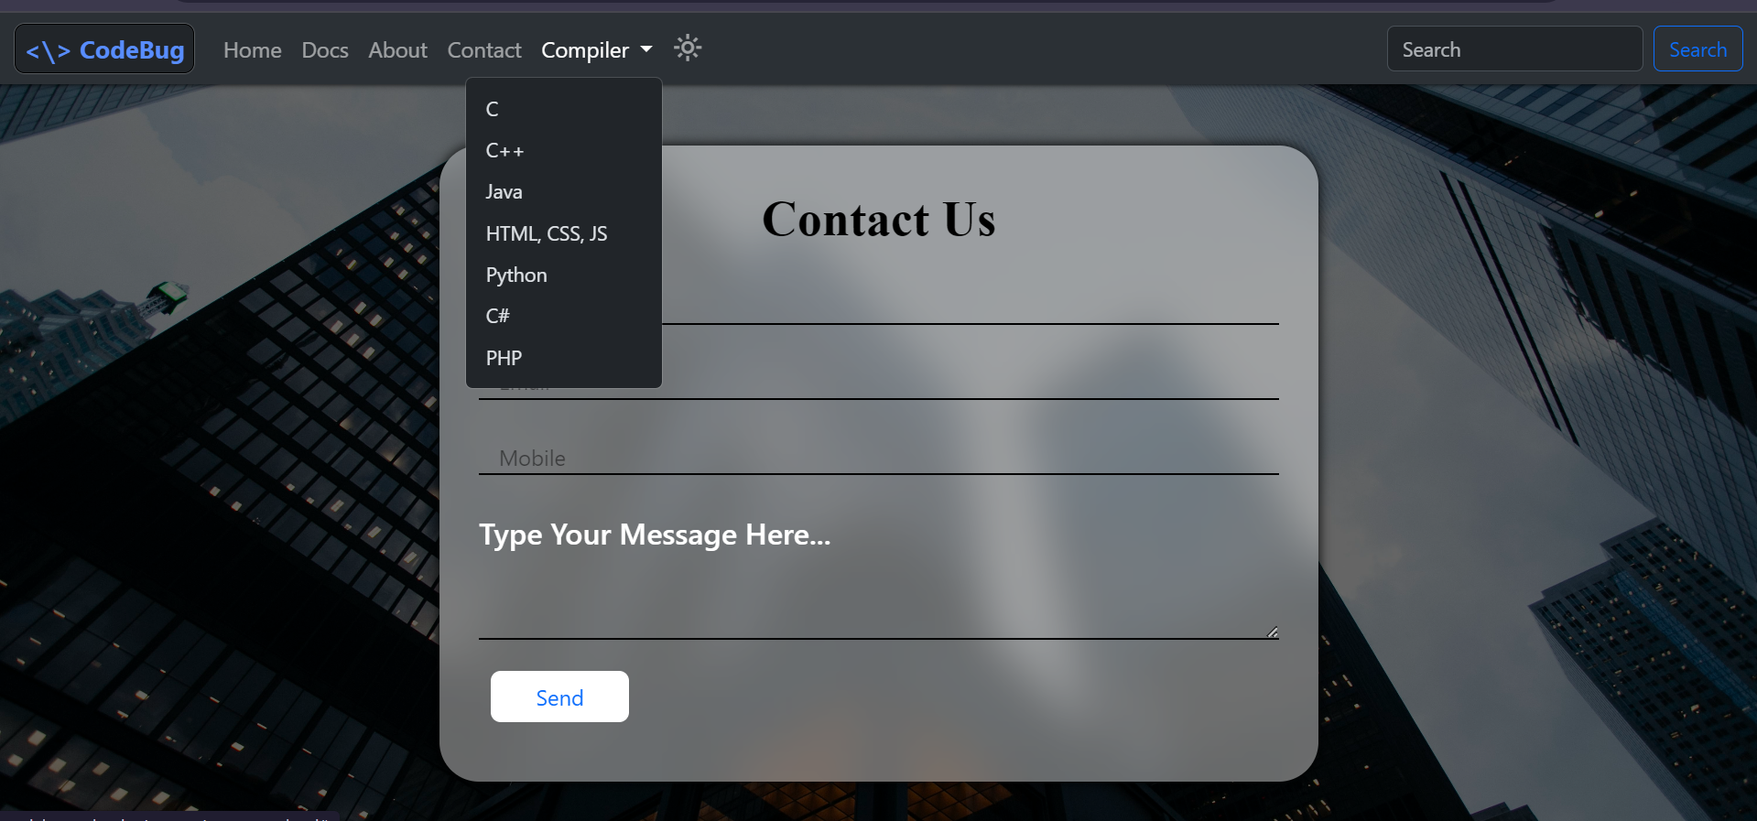
COMPILER

Slide 19
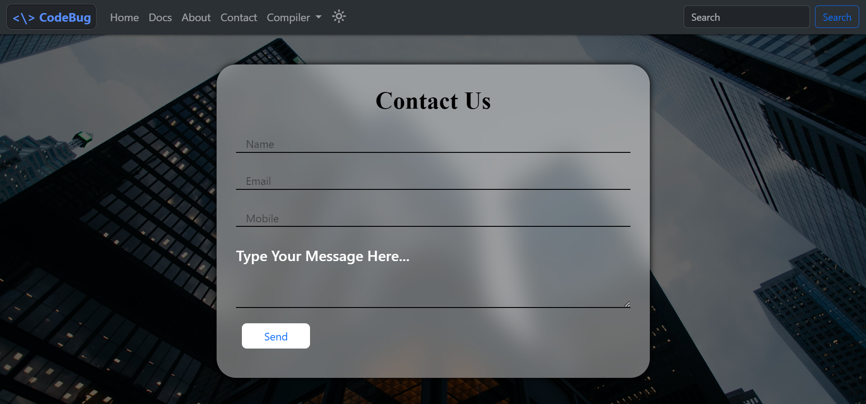
CONTACT PAGE

